Slide 1
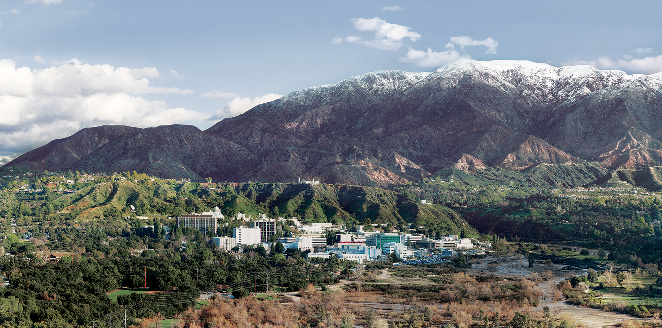
9. The Atmosphere
Dr. David R. Thompson
Jet Propulsion Laboratory, Imaging Spectroscopy Group
July 20, 2019

Slide 2
Goals for this module
Transform reflectance to simulated radiance for a known observing geometry
Apply basic atmospheric effects of scattering and absorption
Invert measured radiances to estimate surface reflectance

Slide 3

Spectral Surface Reflectance
The surface reflectance represents the fraction of incident light reflected in every wavelength.
Aerosols
(absorption and scattering)
Atmospheric gases
(absorption)
Surface reflectance

Slide 4
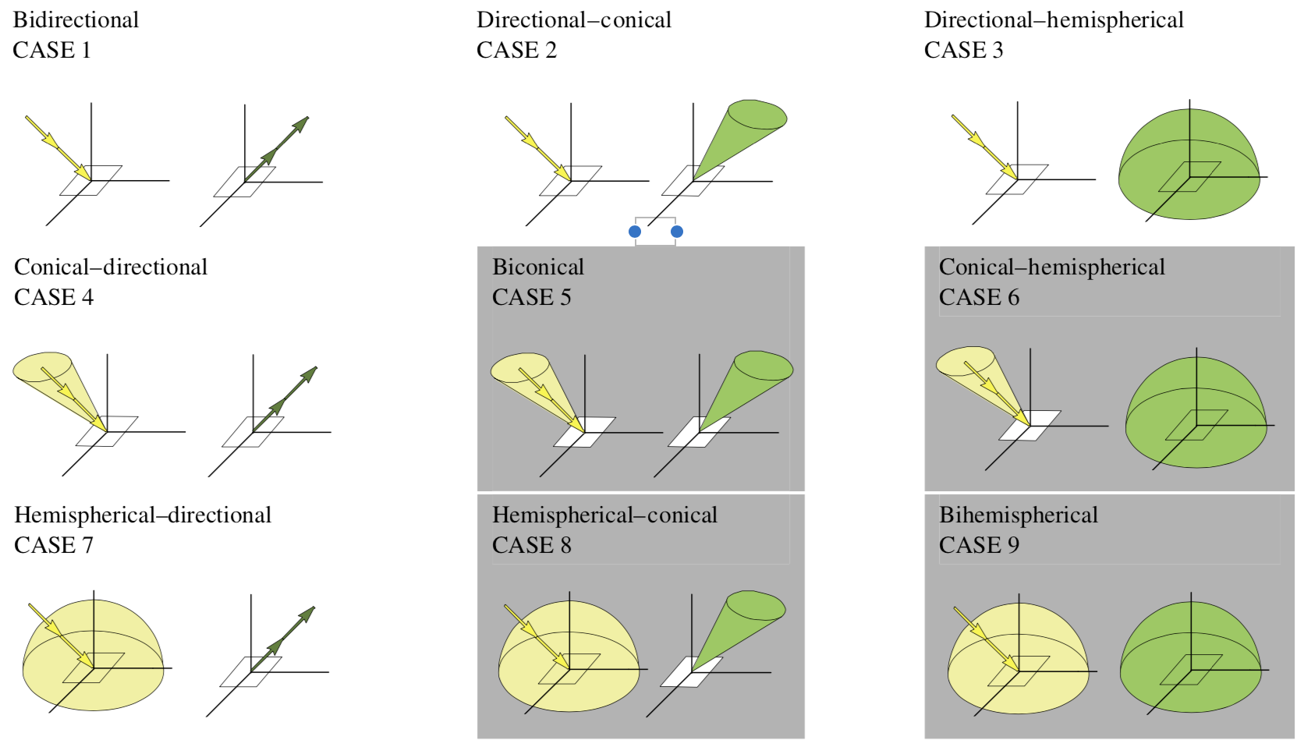
Spectral Surface Reflectance
“Reflectance” is a generic term and can refer to many different physical quantities. The reflected fraction is dependent on the angle of incoming and outgoing light. This defines 9 different reflectance quantities depending on whether we are describing properties of an infinitesimal ray, conical area, or hemisphere. [Schaepman-Strub 2006]

Slide 5
Atmospheric correction
Estimating surface reflectance involves estimating atmospheric constituents to remove their distortion of the ground spectrum.
It is important to retrieve the atmosphere directly from the data, because properties like the column water vapor vary on extremely short spatial scales.
“AVIRIS Classic” imaging spectrometer, visible wavelengths
Retrieved Water vapor
[Thompson et al., Surv. Geophys. 2019]
Notes:
Spatiotemporal variability means we must estimate the atmosphere independently in each spectrum.

Slide 6
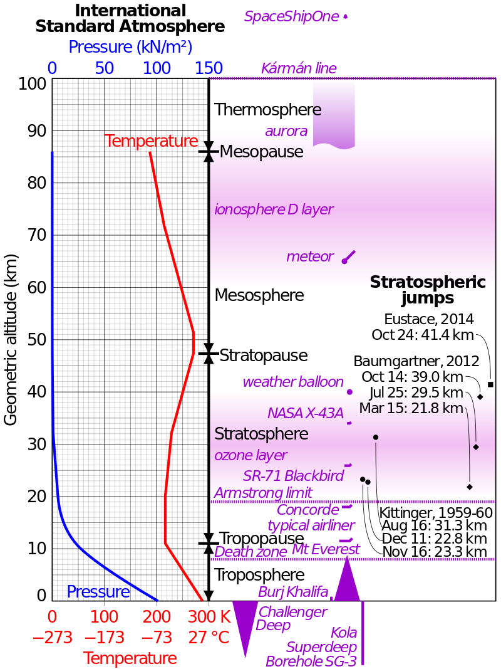
Atmospheric models
Typically a stack of homogeneous layers representing vertical distributions of temperature, pressure, the abundance of atmospheric gases and particle aerosols.
Some gases are well-mixed in the atmosphere (e.g. O₂) while others may be localized.
Most water vapor is here
[Thompson et al., Surv. Geophys. 2019]
Atmospheric gas absorptions

Slide 7
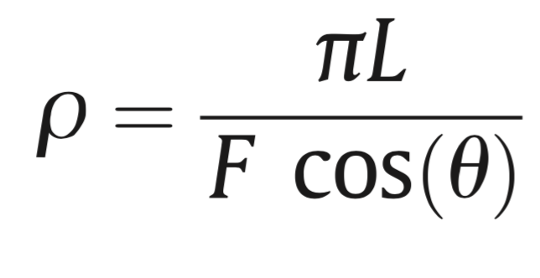
Top of Atmosphere (TOA) reflectance
For convenience, we transform the radiances into a TOA reflectance quantity – the apparent “reflectance” of the Earth and atmosphere, which normalizes out variability in the solar illumination
Radiance at sensor
Solar irradiance
Solar zenith angle

Slide 8
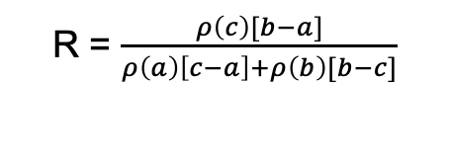
Estimating “band depths”
The depth of a gas absorption feature is related to its abundance along the optical path from sun, to ground, to sensor. This quantity can be used to estimate the amount of a variable gas like H₂O vapor.
A classic approach, the continuum-interpolated band ratio, draws a line across the absorption feature and then measures the depth relative to that “continuum.” It is written as:
b
a
R = $\frac{ρ\left(c\right)[b−a]}{ρ\left(a\right)\left[c−a\right]+ρ\left(b\right)[b−c]}$
c

Slide 9
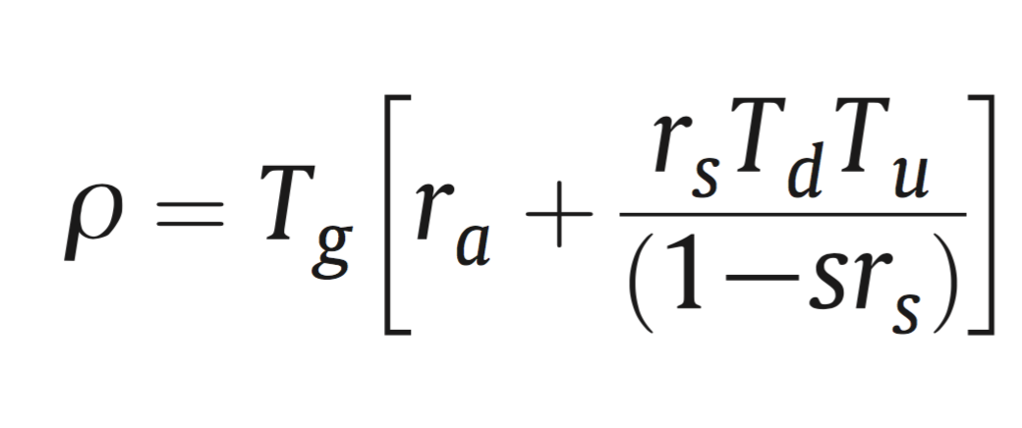
Decoupled RTM approximation
For a Lambertian surface, the TOA reflectance can be written using the following relationship.
[Tanre et al., 1990;
Gao et al., 1993; Thompson et al., 2015]
Gas absorption
Surface reflectance
Transmittance due to scattering
Path reflectance
Spherical albedo
Aerosols
(absorption and scattering)
The coefficients T_{g}, T_{d}T_{U}, r_{a} and s can be calculated using Radiative Transfer Models (RTMs) like MODTRAN, LibRadTran, 6SV, et cetera.
H₂O column vapor
(absorption)
Surface reflectance

Slide 10
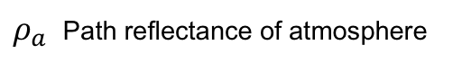
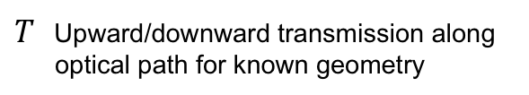
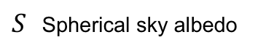
“Classic” atmospheric correction
Lookup table indexed by H₂O, etc.
1. In advance, do RTM calculations for a grid of atmospheric conditions:
$ρ_{a}$ Path reflectance of atmosphere
$S$ Spherical sky albedo
$T$ Upward/downward transmission along optical path for known geometry
Notes:
With atmospheric state specified, We can get optical constants via linear lookup table interpolation (note: T=transmission, S=spherical sky albedo, rho_a is the path reflectance).
This is just one of several similar functional approximations to the actual radiative transfer solution. With atmosphere specified, we can invert it algebraically to recover the surface reflectance.
The conventional strategy is limited in sever

Slide 11
“Classic” atmospheric correction
2. Analyze radiance to estimate this atmosphere (typically using band ratios).
Lookup table indexed by H₂O, etc.
1. In advance, do RTM calculations for a grid of atmospheric conditions:
$ρ_{a}$ Path reflectance of atmosphere
$S$ Spherical sky albedo
$T$ Upward/downward transmission along optical path for known geometry
Notes:
With atmospheric state specified, We can get optical constants via linear lookup table interpolation (note: T=transmission, S=spherical sky albedo, rho_a is the path reflectance).
This is just one of several similar functional approximations to the actual radiative transfer solution. With atmosphere specified, we can invert it algebraically to recover the surface reflectance.
The conventional strategy is limited in sever

Slide 12
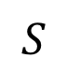
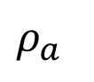
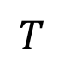
“Classic” atmospheric correction
2. Analyze radiance to estimate this atmosphere (typically using band ratios).
3. Look up and/or interpolate optical coefficients
Lookup table indexed by H₂O, etc.
$ρ_{a}$
$$S$$
$$T$$
1. In advance, do RTM calculations for a grid of atmospheric conditions:
$ρ_{a}$ Path reflectance of atmosphere
$S$ Spherical sky albedo
$T$ Upward/downward transmission along optical path for known geometry
Notes:
With atmospheric state specified, We can get optical constants via linear lookup table interpolation (note: T=transmission, S=spherical sky albedo, rho_a is the path reflectance).
This is just one of several similar functional approximations to the actual radiative transfer solution. With atmosphere specified, we can invert it algebraically to recover the surface reflectance.
The conventional strategy is limited in sever

Slide 13
“Classic” atmospheric correction
2. Analyze radiance to estimate this atmosphere (typically using band ratios).
3. Look up and/or interpolate optical coefficients
Surface reflectance
TOA reflectance
Lookup table indexed by H₂O, etc.
4. Algebraic Inversion
1. In advance, do RTM calculations for a grid of atmospheric conditions:
$ρ_{a}$ Path reflectance of atmosphere
$S$ Spherical sky albedo
$T$ Upward/downward transmission along optical path for known geometry
Notes:
With atmospheric state specified, We can get optical constants via linear lookup table interpolation (note: T=transmission, S=spherical sky albedo, rho_a is the path reflectance).
This is just one of several similar functional approximations to the actual radiative transfer solution. With atmosphere specified, we can invert it algebraically to recover the surface reflectance.
The conventional strategy is limited in sever

Slide 14
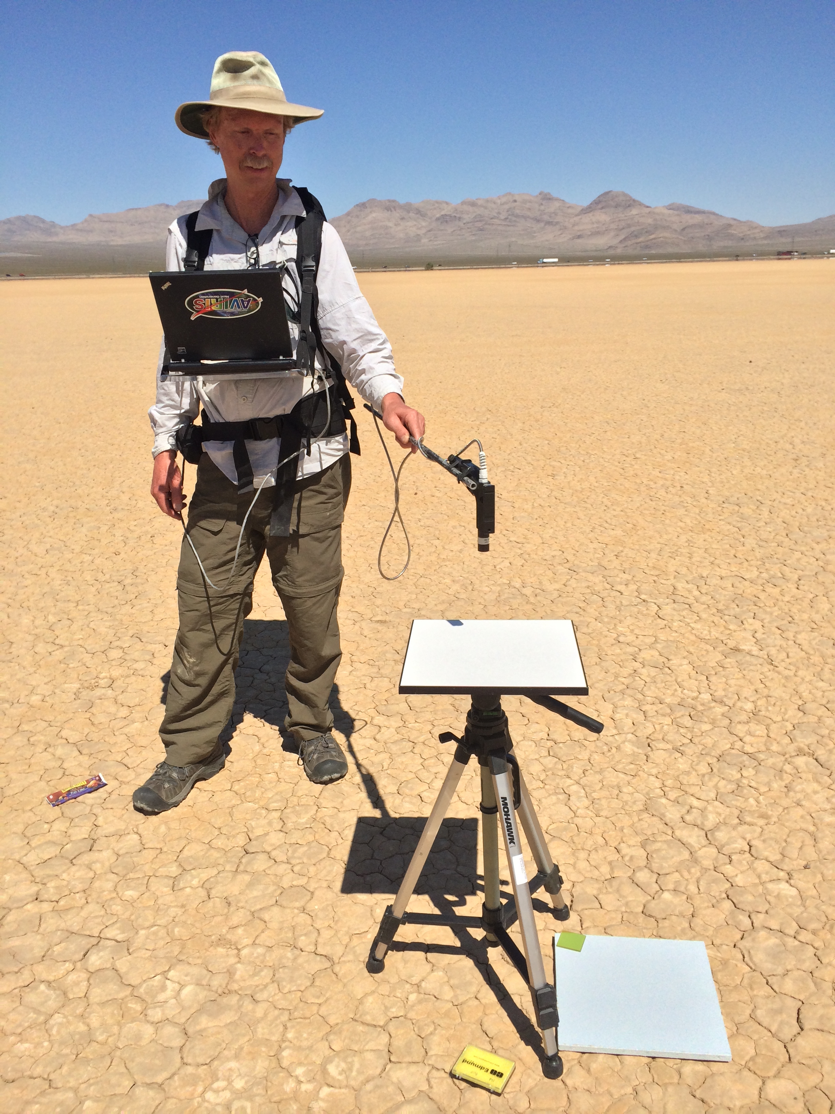
Validating atmospheric correction
Typical validation experiments involve constraining the terms in the TOA reflectance equation by measuring the surface and atmospheric aerosols in-situ, and then simulating the measurement at sensor. Equivalently, one can invert the radiance using retrieved or measured atmospheres, and evaluate the match with in-situ reflectances. 2-4% error is typical.
[Thompson et al., Surv. Geophys. 2019]
Scott Nolte, JPL
Notes:
Posterior uncertainty predictions (grey envelopes) accurately predict and capture our actual discrepancies!
This demonstrates a closed account of the uncertainty in the system. To our knowledge, this is the first time it has been done for VSWIR imaging spectroscopy.
Note: we also account for the uncertainty in the surface measurement, which is a significant contributor to the confidence bands.

Slide 15
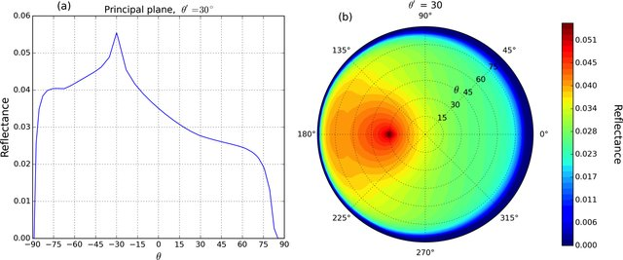
Beyond Lambertian surfaces
The algebraic formulation assumes the surface is Lambertian, i.e. reflectance is the same in all directions. More sophisticated angle-dependent models exist. They are particularly useful for complex surfaces like vegetation. Below: the Ross-Li Vegetation BRDF.
Image: Ross-Li kernel from Lorente et al., The importance of surface reflectance anisotropy for cloud and NO2 retrievals from GOME-2 and OMI, July 2018 Atmospheric Measurement Techniques 11(7):4509-4529

